Slide 1
Keeping it in the family
When to marry your cousin

Slide 2
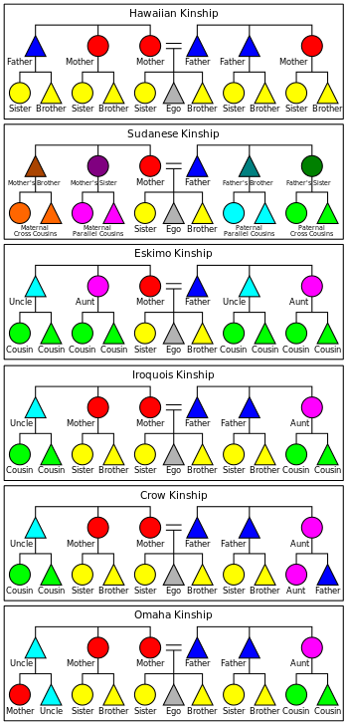
Societies differ in how they refer to their cousins
Hawaiian kinship
Cousins and siblings are all the same thing
Eskimo kinship (ours)
Cousins are all the same but different from siblings
No particular distinction between cousins
Sudanese kinship
Cousins are all different
Iroquois kinship
Parallel cousins are siblings
Distinction between parallel cousins and cross cousins
Parallel cousins – children of two brothers, or children of two sisters.
Cross cousins – children of a brother and a sister. Equally close genetically but may be less close socially.
Crow kinship
Cross cousins on father’s side are special
Omaha kinship
Cross cousins on mother’s side are special
https://en.wikipedia.org/wiki/Kinship_terminology

Slide 3
The distinction between cross cousins and parallel cousins matters when building marriage alliances
Near-universal incest taboo - people don’t marry their close relatives
This may be defined by social group
Marriages between social groups are promoted, to build alliances
Cross cousins are members of different social groups and thus eligible marriage partners
Cross cousins
Marriage forms alliance between groups
Parallel cousins
Belong to the same group – this would be incest!
http://classes.uleth.ca/200501/anth2010a/Alliance%20Lecture%20Notes.htm

Slide 4
“Marriage is promoted between [cross cousins] in the Iroquois system”
- Anonymous author on Wikipedia, citing no evidence
https://en.wikipedia.org/wiki/Parallel_and_cross_cousins

Slide 5
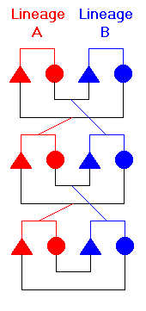
Investigating alliance theory cross-culturally
Ethnographic evidence in favour of alliance theory: Yanomami marriage exchange consistent with coupled vertical transmission of social, classification and marriage systems
Does this apply cross-culturally and across language families?
If alliance theory is correct, phylogenetic methods should detect a signal → do we find this relationship in Bantu societies?
First steps: Github for data integration and sharing code; Sources: D-PLACE: data on kinship classification systems and preferential cross-cousin marriage in Bantu societies + Glottolog tree

Slide 6
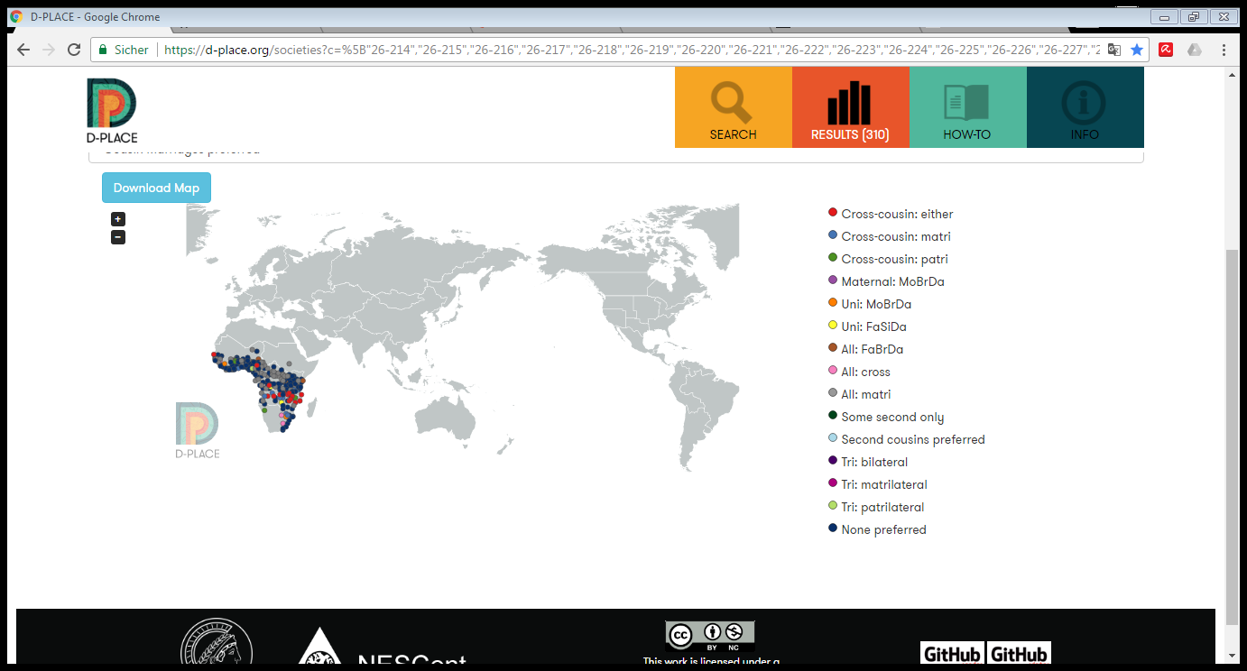

Slide 7
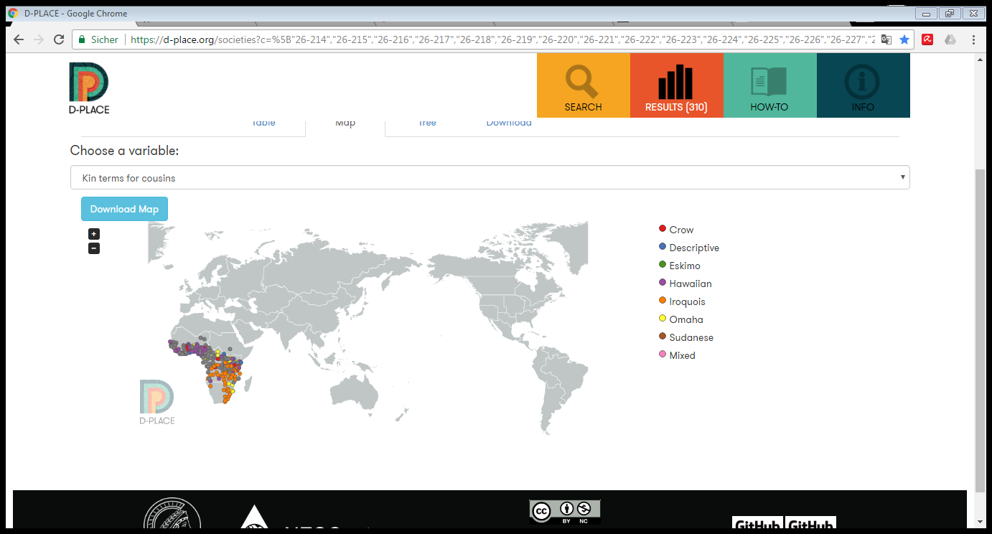

Slide 8
Methods
Re-coding:
Iroquois-Crow-Omaha grouped together as differentiating between cross-cousins and parallel cousins; Hawaiian and Eskimo grouped together as not differentiating between CC and PC;
marital preferences: coded between presence or absence of preferential cross-cousin marriage
Data matching (traits to tree) in R and Python
Model comparison in BayesTraits Discrete (maximum likelihood with likelihood ratio)

Slide 9
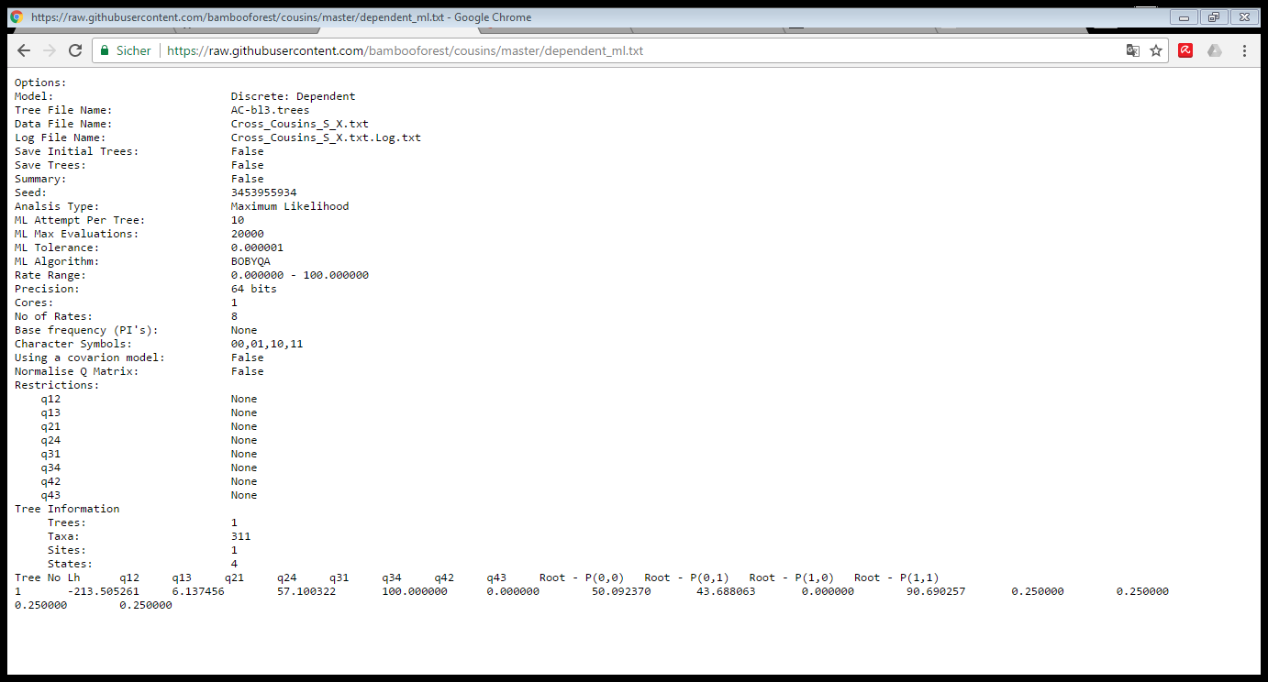

Slide 10
Results
Results: support for dependent model → consistent with alliance theory…
BUT: conflicting signal at deepest nodes of the tree; parameter values for transitions between character states not entirely consistent (with any particular scenario); missing data → possible bias?
→ not (yet) conclusive

Slide 11
Investigating alliance theory cross-culturally
Preference for marrying cross-cousins might vary across language families in unpredicted ways, if we assume that marriage patterns are inherited within language communities
preferredi ∼ Binomial(distinguishedi, pi) | likelihood
logit( pi) = αFAMILY[i] | log-odds for language family on row i
αFAMILY[i] ∼ Normal(α, σ) | varying intercepts prior
α ∼ Normal(0, 1) p | prior for a language family
σ ∼ HalfCauchy(0, 1) | prior for standard deviation of language families

